Slide 1
$Make it Rain$ Fintech & Society
Loc Nguyen
CS.4630.01

Slide 2
Table of contents
01
Background
02
Down in the details
03
Impact
A look into history of finance and tech
Algorithmic trading
How does algorithmic trading affect market & society

Slide 3
01
Background

Slide 4
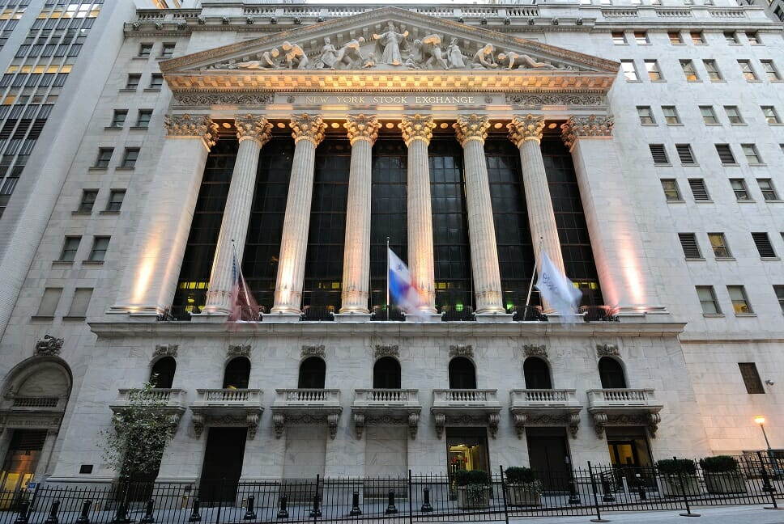
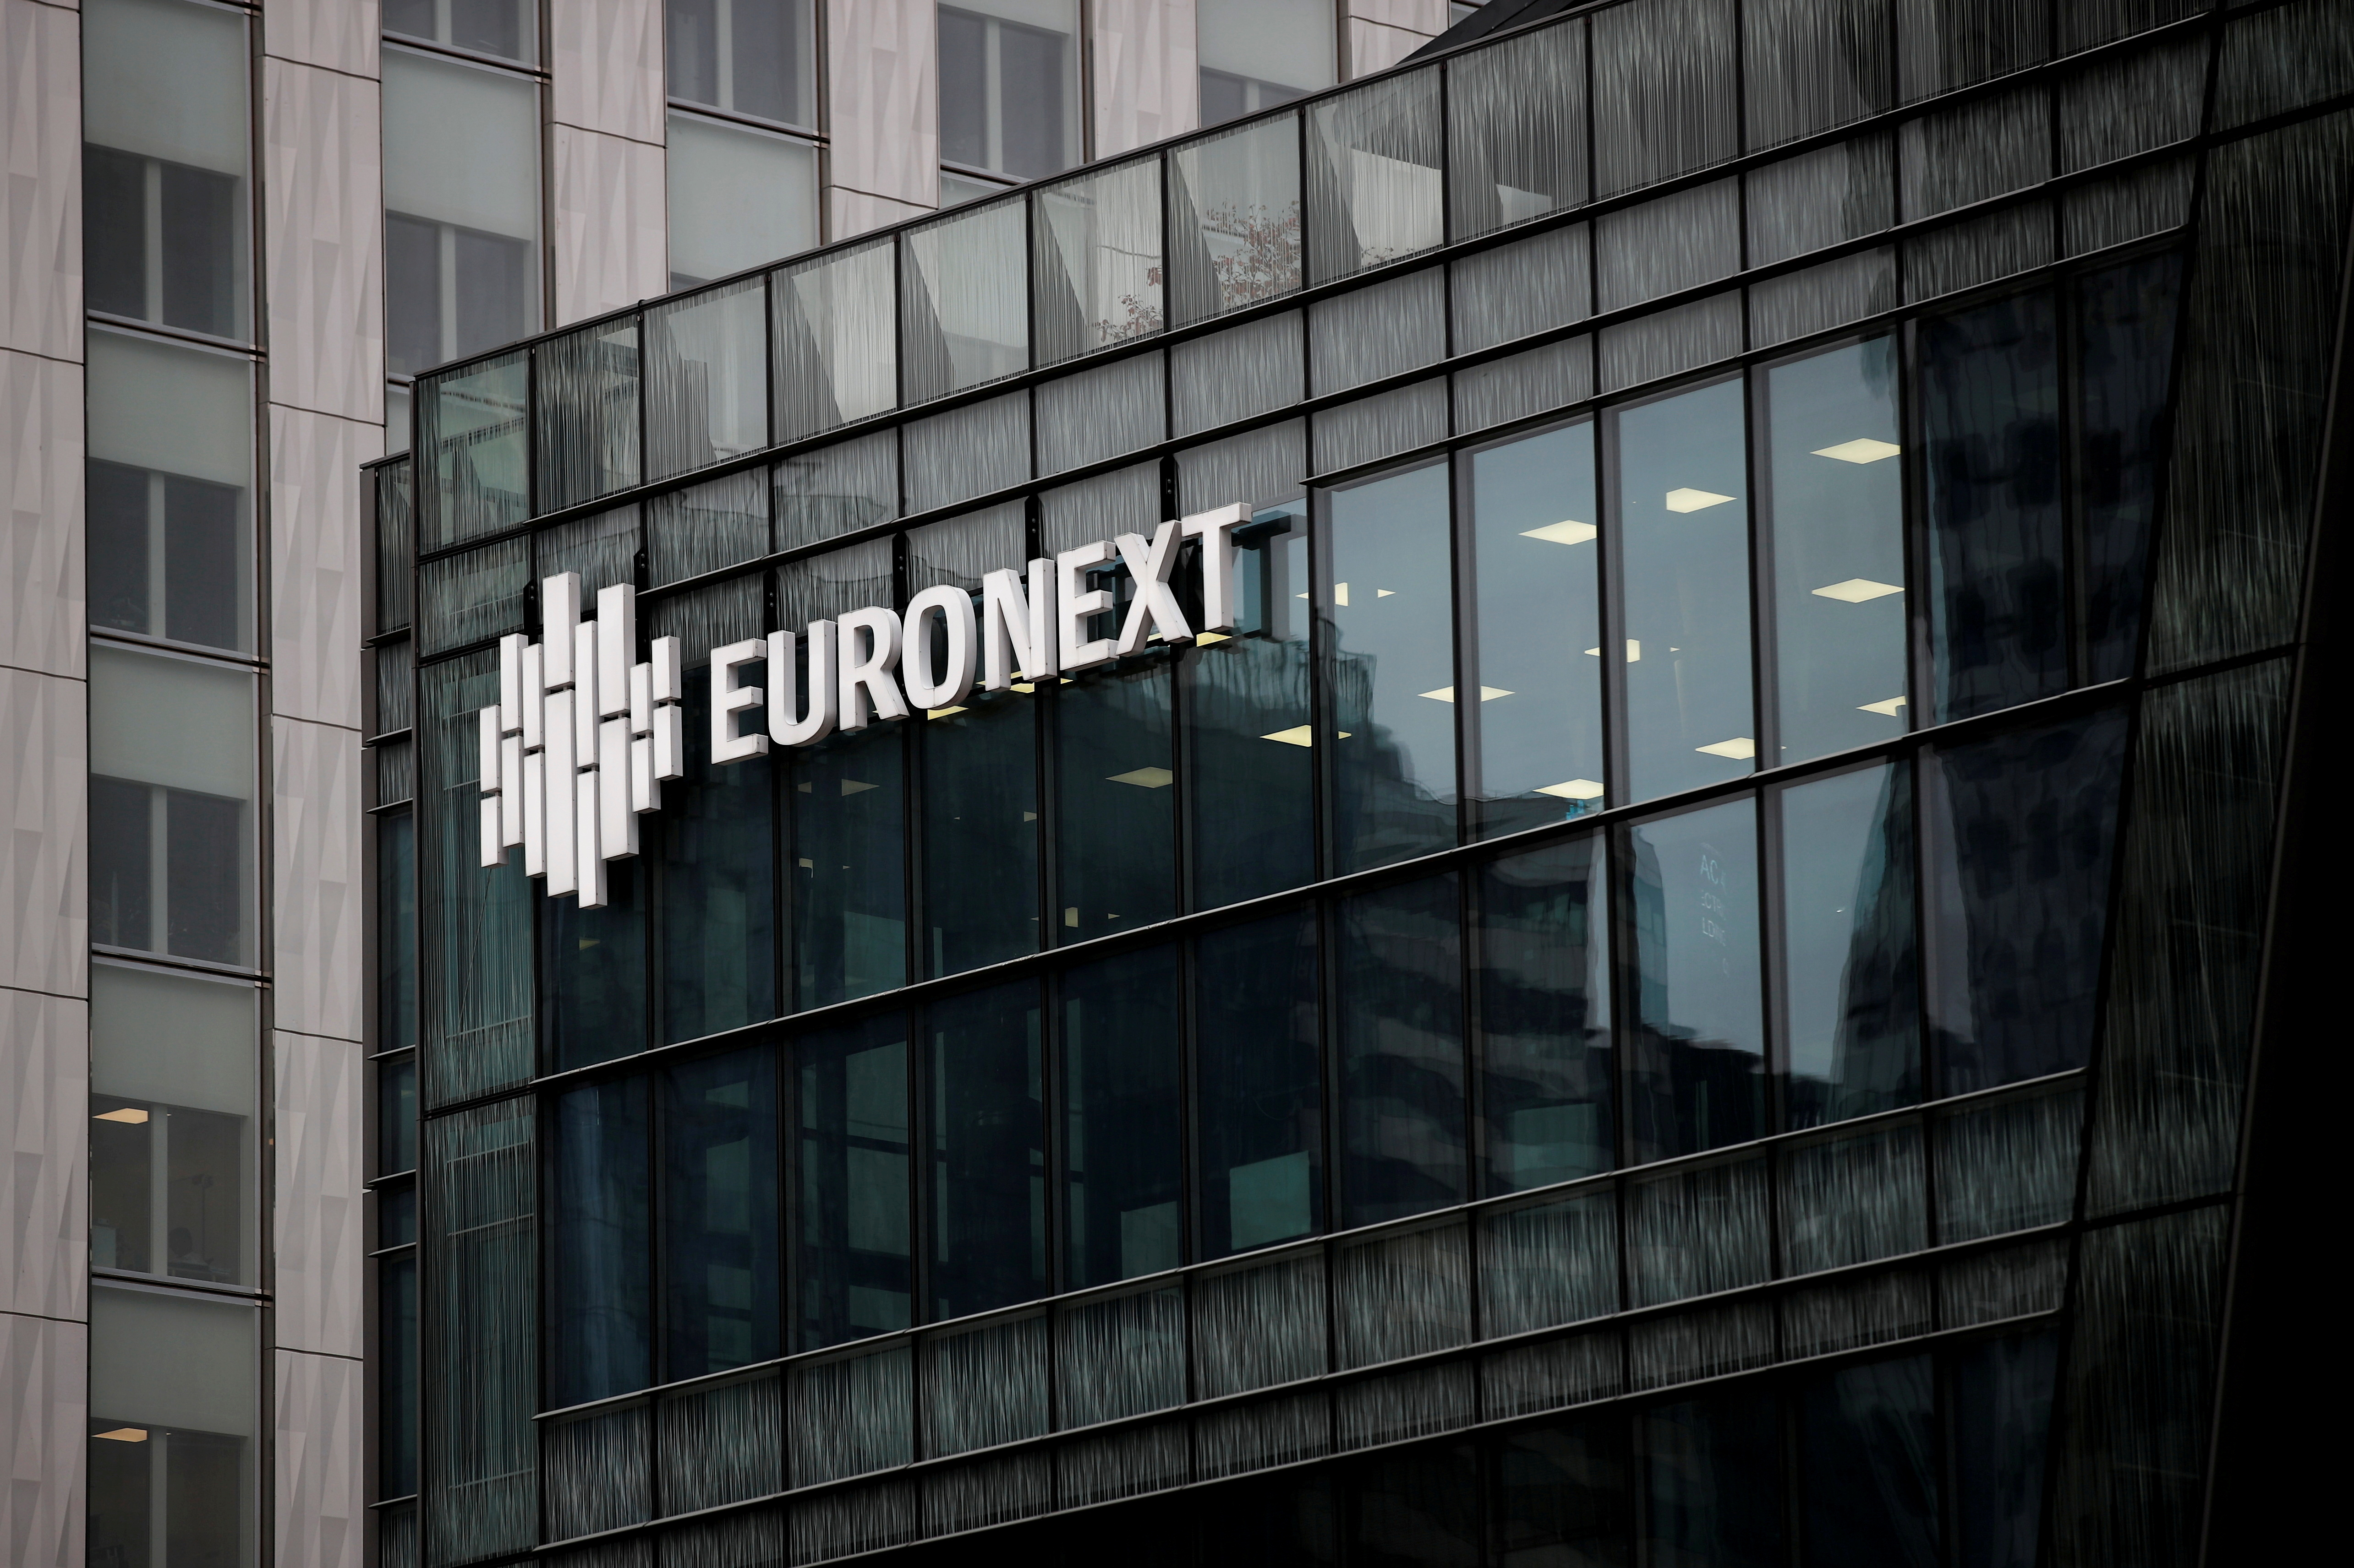
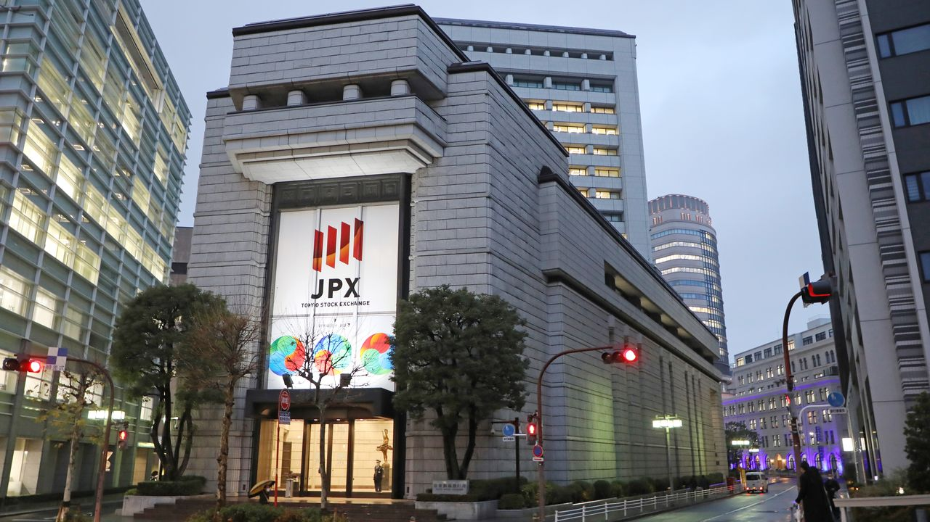
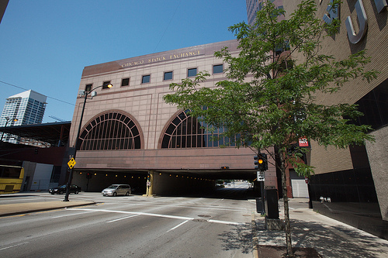
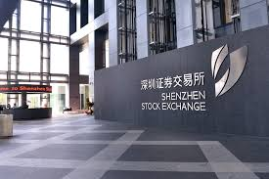
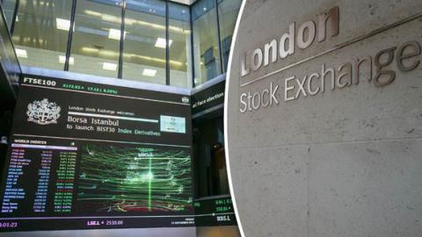
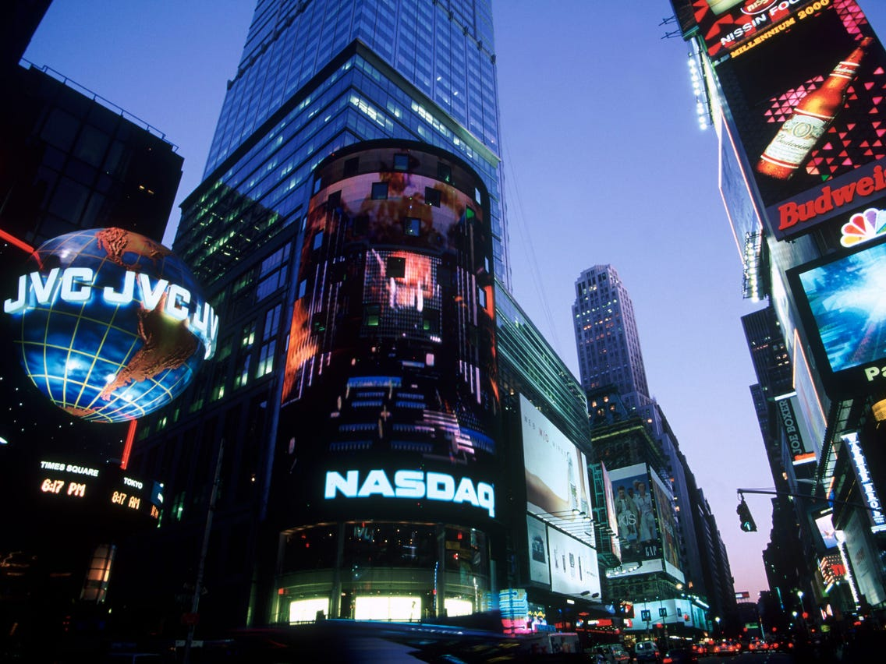
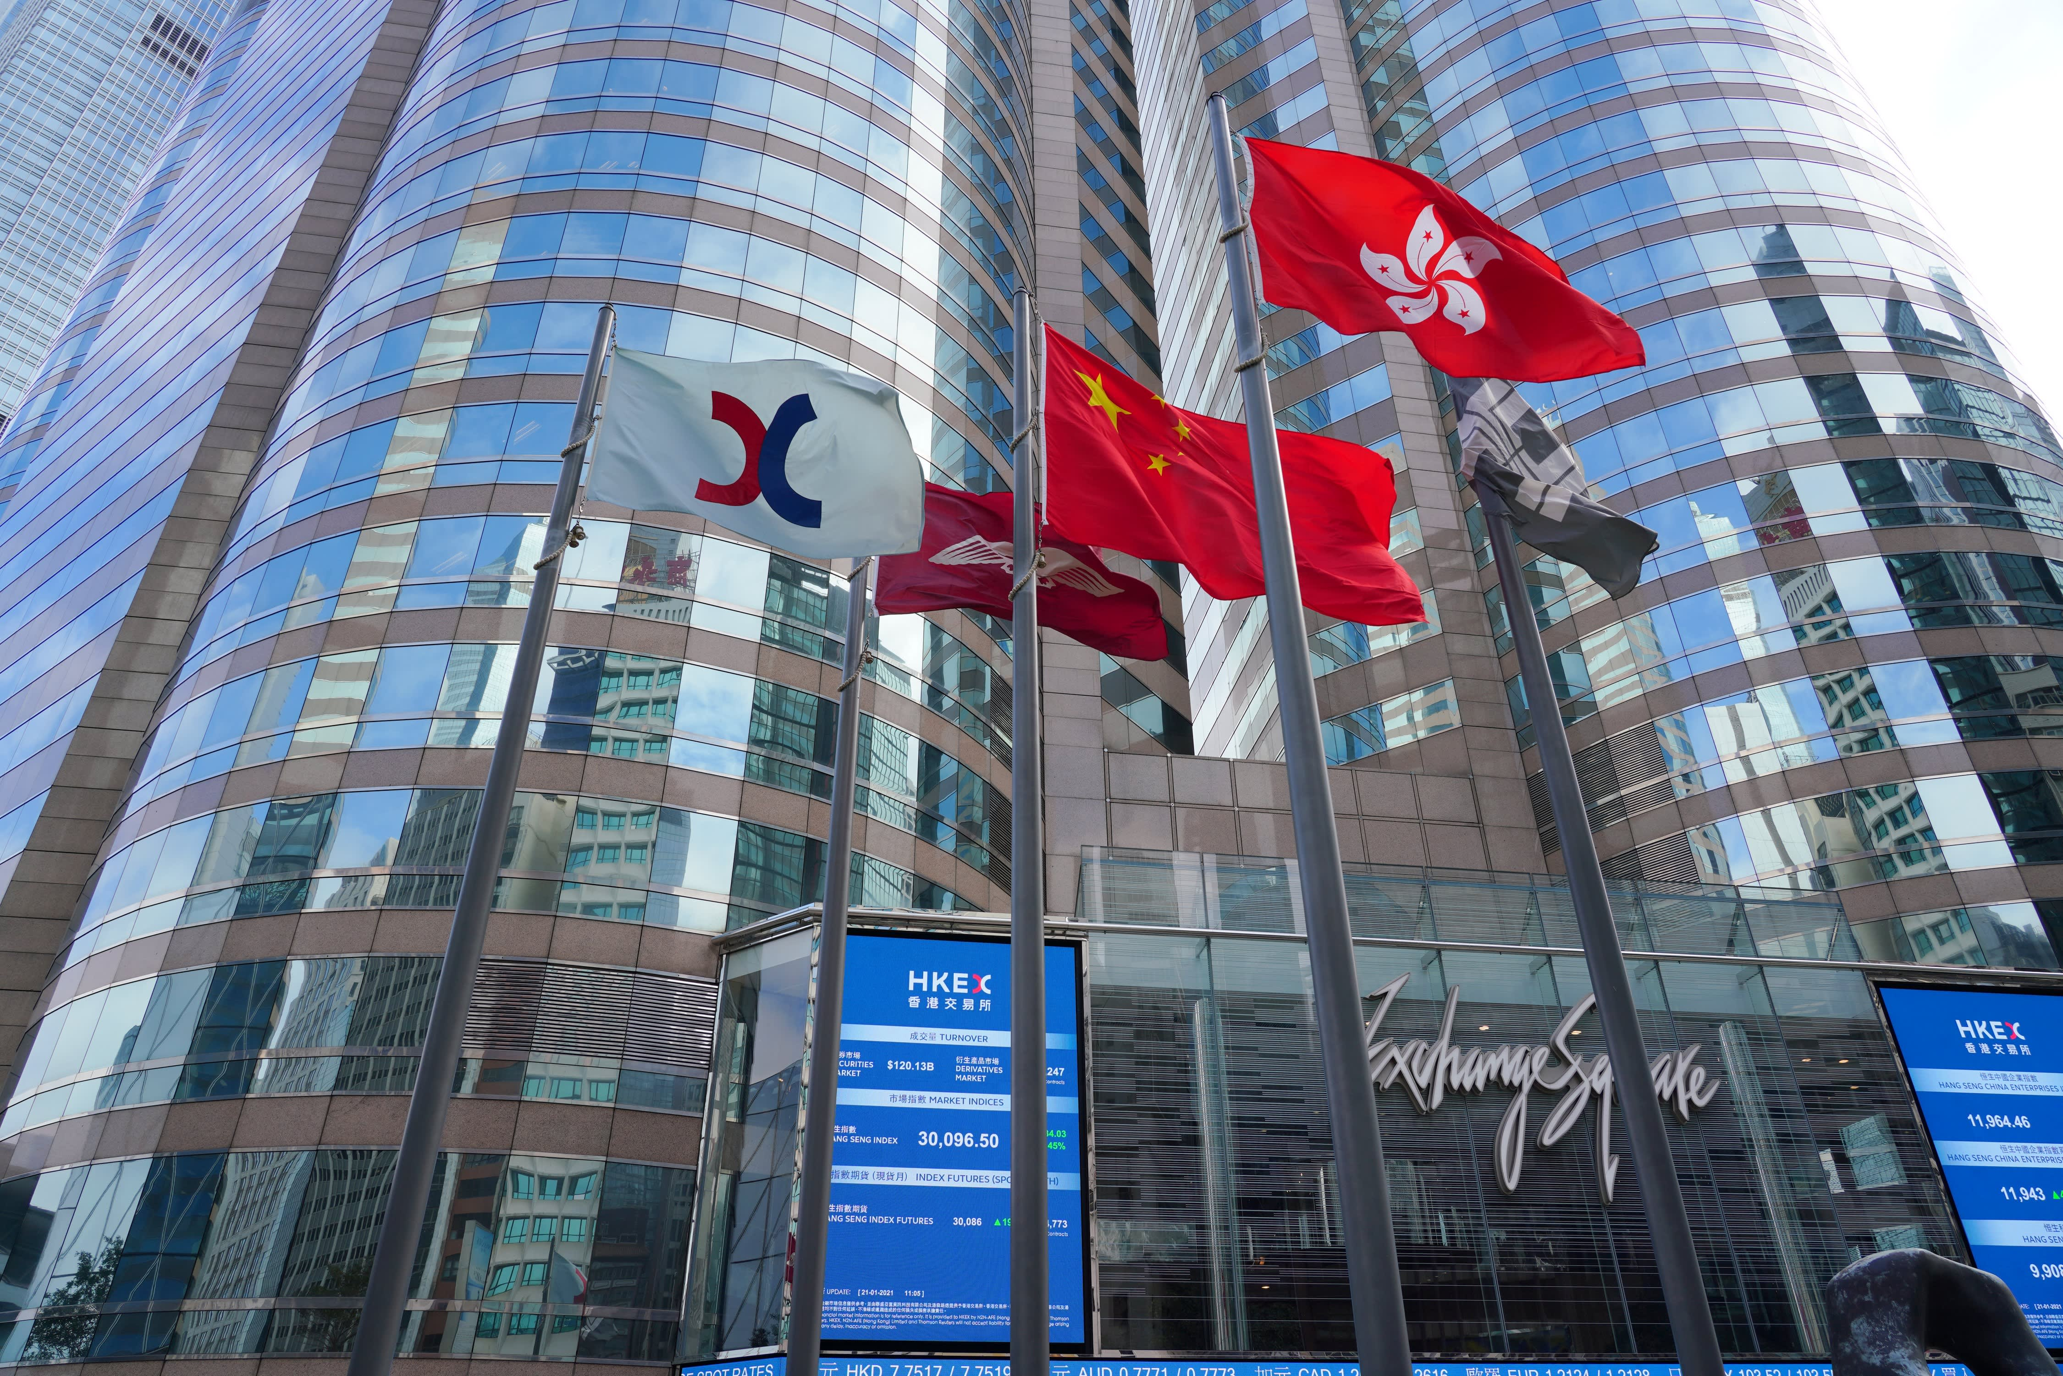
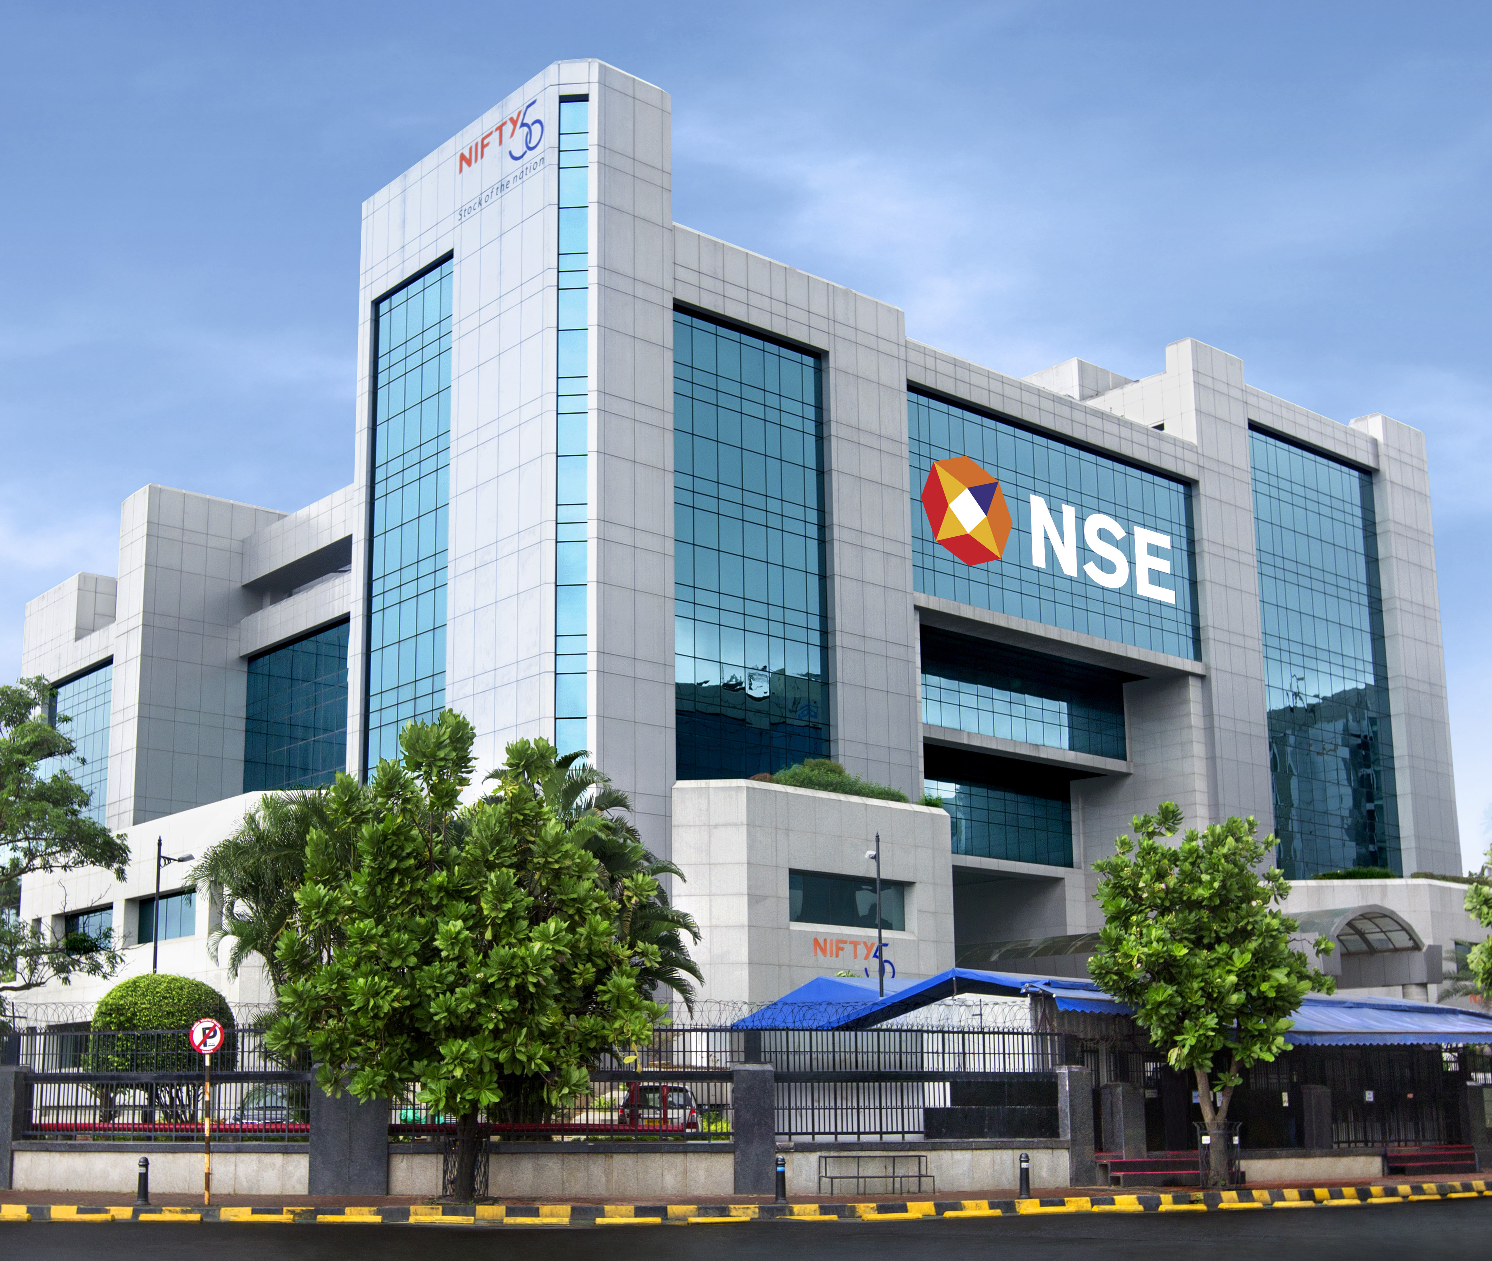

Slide 5
Anyone heard of Medallion Fund?

Slide 6
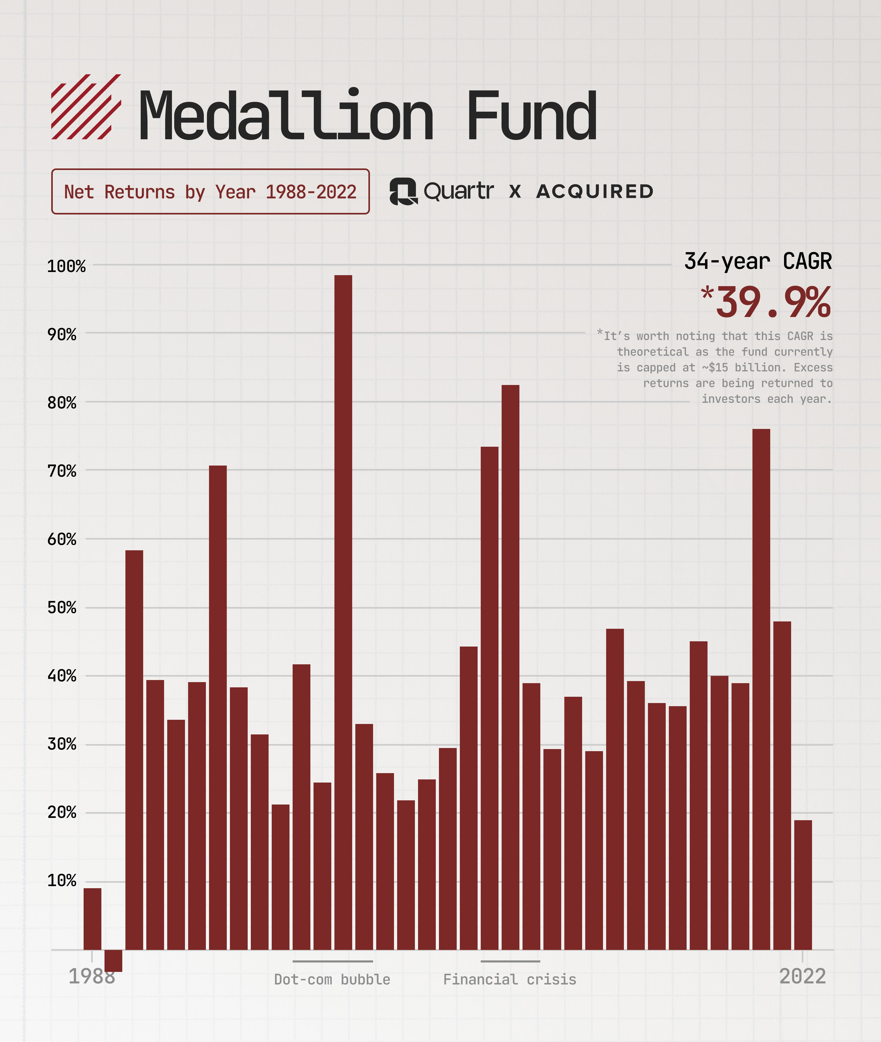
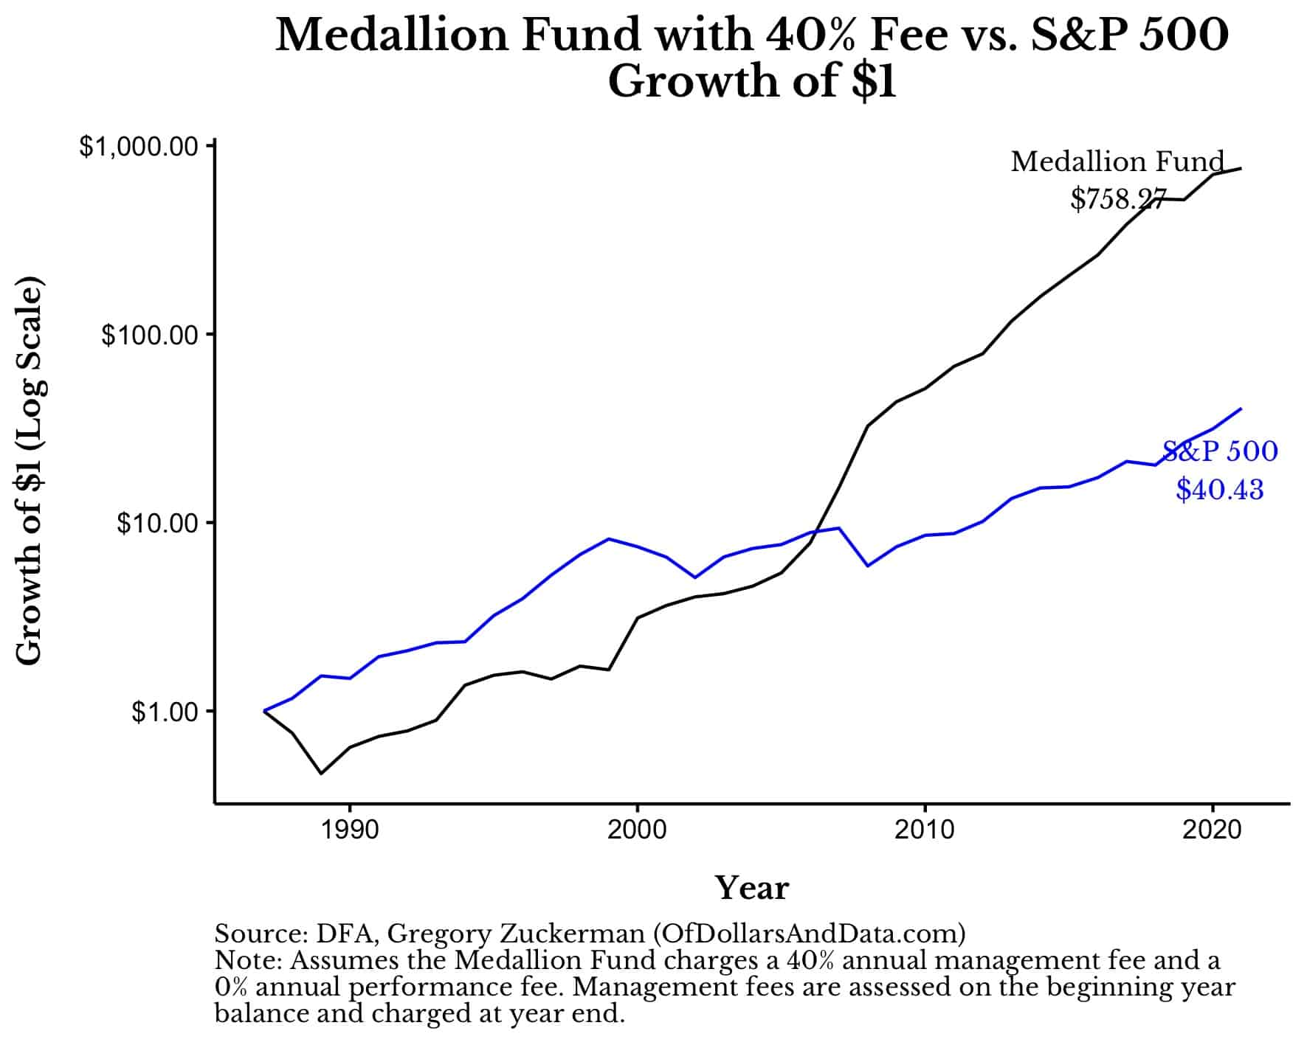
Check this out!

Slide 7
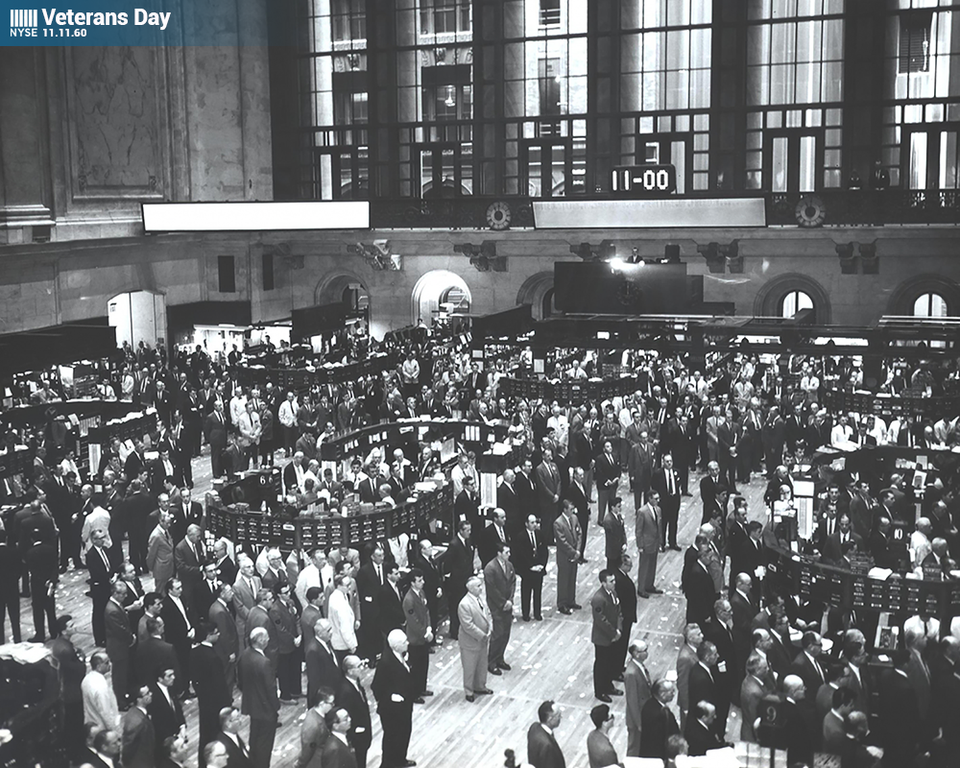
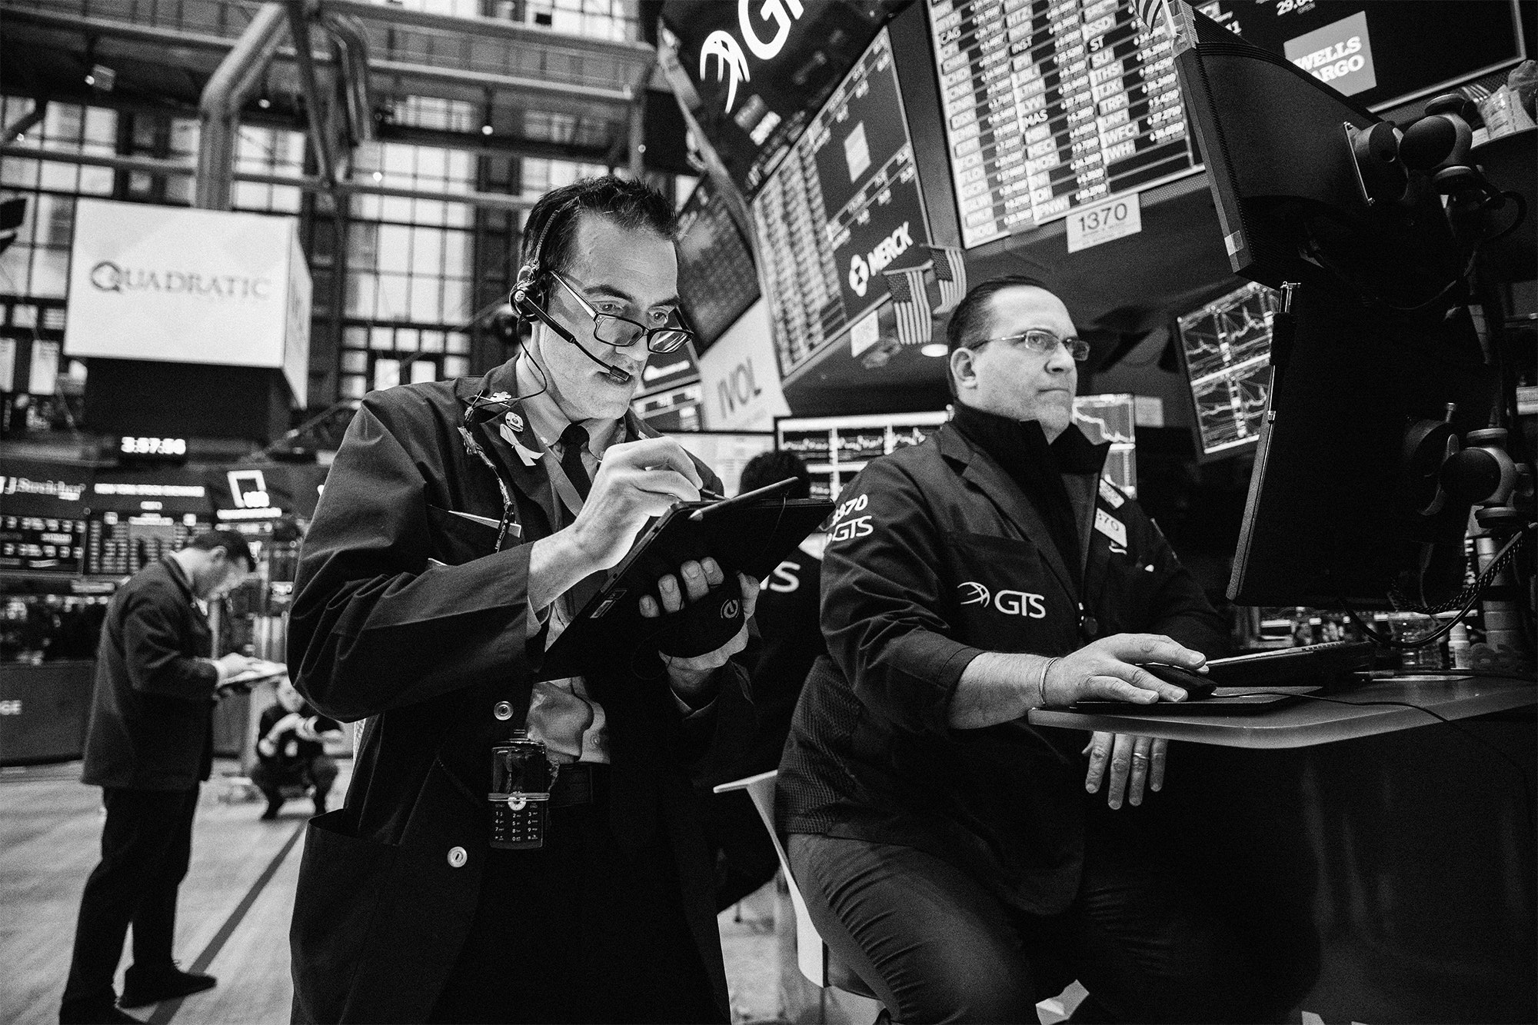
A look down memory lane…
In the 70s, simple rule-based systems were used to execute trades primarily for BEST PRICE
Orders consisted of market, limit, and stop-loss
In the 80s, more sophisticated algorithm was developed
Able to IDENTIFY OPPORTUNITES from market data using computers
In the 90s, electronic trading becomes widespread, making trades more efficient and quicker
Access multiple exchanges & liquidity pools

Slide 8
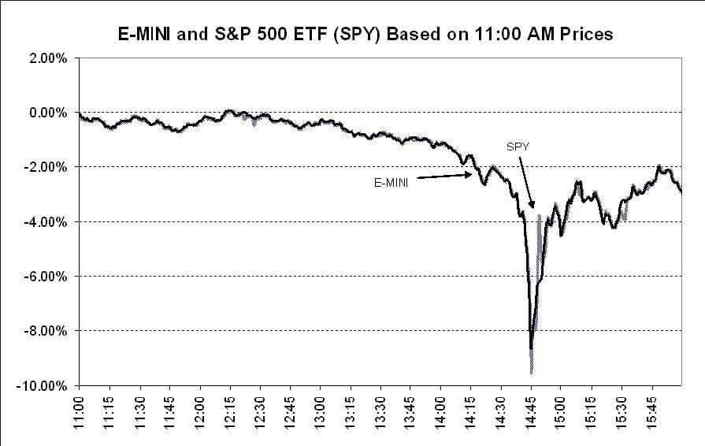
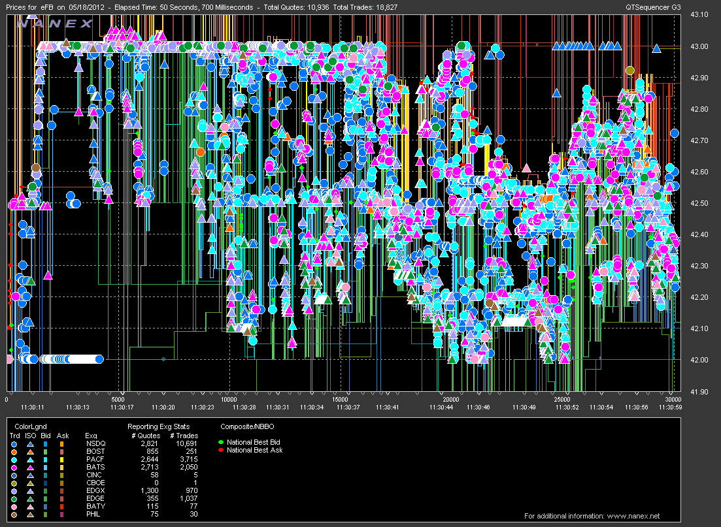
A step into the early days
Rise of HFT using advanced algorithms & trading strategies to execute trades in fractions of seconds
Fueled by computing power, data processing, and low-latency networks (fiber optic)
Concerns about stability and fairness of financial markets (e.g. 2010 flash crash) due to HFT & derivatives

Slide 9
How can YOU make money?
DATA!!!
DATA!!!
DATA!!!
LOTS OF IT!
And remember…

Slide 10
Buy LOW Sell High

Slide 11
02
AlgoTrade in a Nutshell
How to make it rain

Slide 12
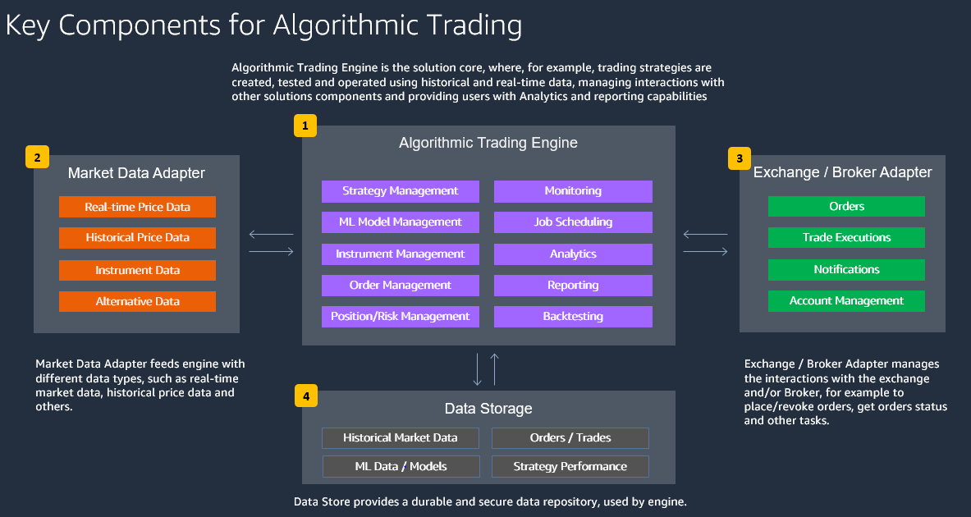

Slide 13
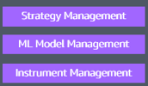
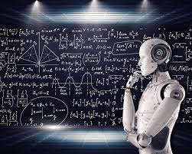

Step 1 – The Researcher
Trading engines are the bread & butter
Strat – Momentum-based, arbitrage, etc.
ML model – training, testing, tracking, analysis, retraining
Instruments – Stocks, shorts, futures, options, forex, etc.

Slide 14
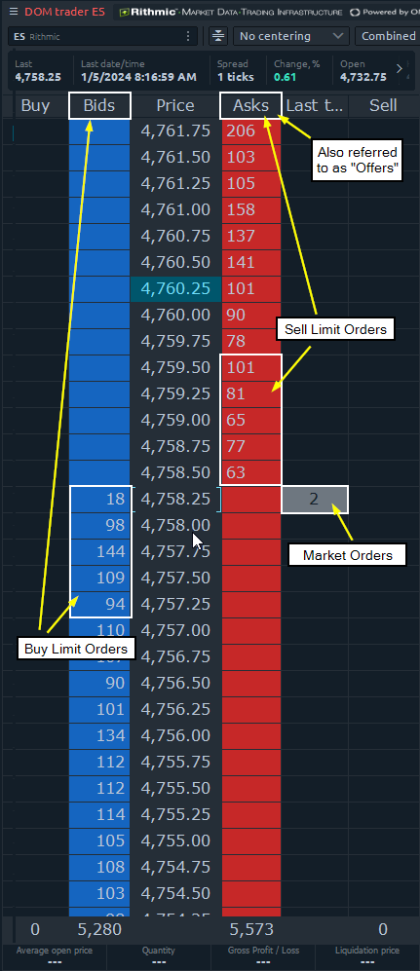
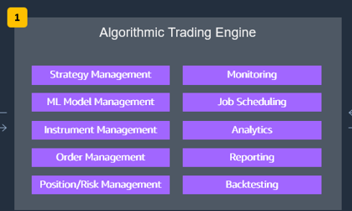
Step 2 – The Scout
Order Mgmt – order flow, quote stuffing & spoofing, bid-ask spread
Risk Mgmt – position sizing, stop-loss, diversification, risk-reward ratios, market conditions
Backtesting – using historical patterns to test how well a model would perform (no need for capital)

Slide 15
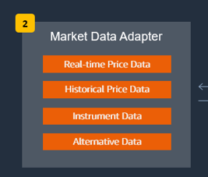
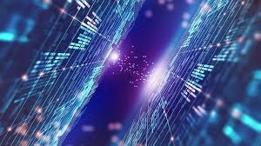
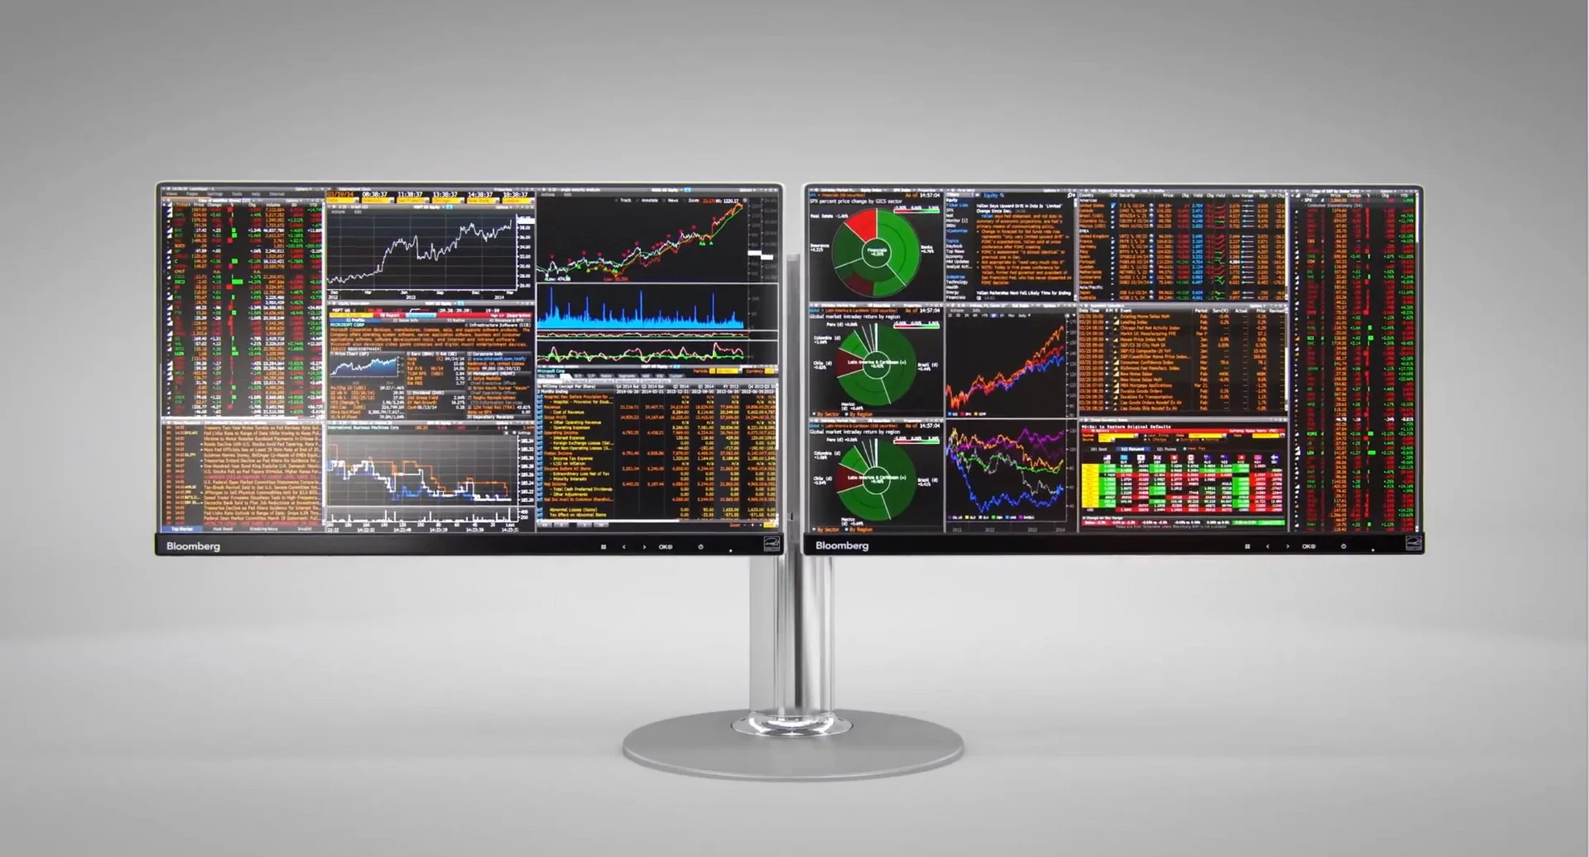
Step 3 – The Librarian
Feeds data to the trading engines
Data access – Bloomberg Terminal
Devaluation & HFT
Private exchange & dark pools for institutional investors

Slide 16
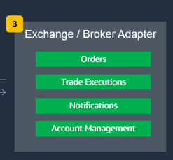
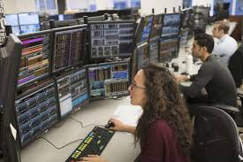
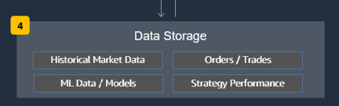
Step 4 & 5 – The Executioner
Trades & orders are finally published on the exchange
Check the status and monitoring market moves
Notify successful trade completion & update account
Continuously capture data & store it for ML model training & evaluation

Slide 17
03
Impact & Future
What now?

Slide 18

Impact & the Future
Blockchain & DeFi – transparency & security
Quantum computing – exponential computing power
Regulatory changes – SEC

Slide 19
Q&A Ask or forever hold your peace And no… there are no dumb questions

Slide 20
Thanks! Discord@locng2021

